Slide 1
RFID BASE ATTENDANCE SYSTEM

Slide 2
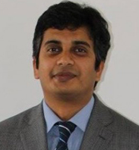
INSTRUCTOR
Md. Sawkat Ali
Assistant Professor
Department of Computer Science and Engineering

Slide 3



MEET THE TEAM
Kazi Sifat Al Maksud
ID: 2019-3-60-050
Noortaz Ahmed
ID:2019-3-60-030
Samiha Korim Chowdhury
ID: 2019-3-60-100

Slide 4
Introduction
What is Microcontroller ?
What is RFID?
RIFD’s working process
Real Life Application

Slide 5
OBJECTIVES
1. Take automatic attendance
2. Prevent Outsider
3. Reduce manually work
4. Save Time

Slide 6
EQUIPMENT & COMPONENTS
Necessary components to build Microcontroller based automatic attendance system
1. 8051 Microcontroller (AT89C51) 2. Alphanumeric 16x2 LCD Display 3. RFID Rider 4. Wire

Slide 7
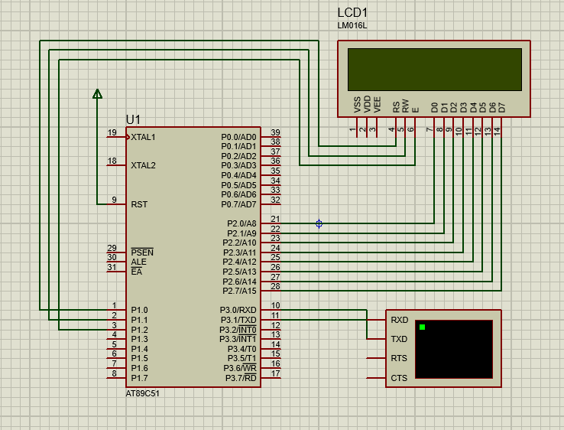
Design
Design of Microprocessor based automatic attendance recorder with RFID system

Slide 8
Implementation
Implementation Steps:
1. Initialize the LCD 2. Initialize the Serial Communication (9600 Baud Rate) 3. Receive the 13 bytes and check 4. And display them into the LCD Display.
In this project, we use only 13 bytes of student id given by our university. But we can take any arbitrary number. If it is matching it can run the motor.

Slide 9
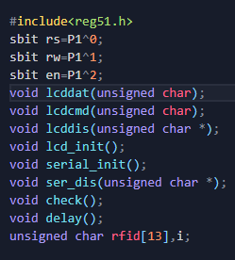
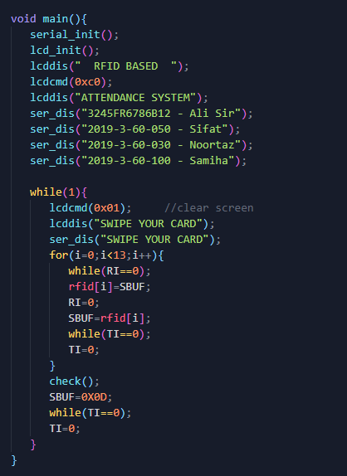

Slide 10


Slide 11
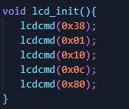
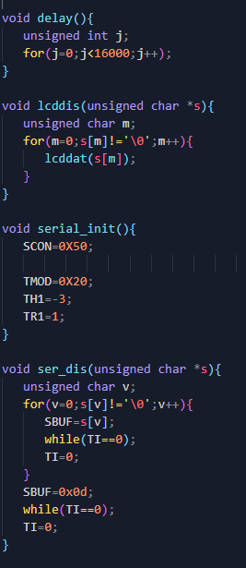
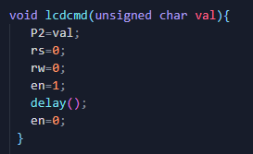
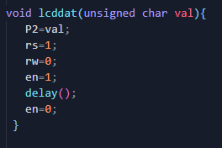

Slide 13
CONCLUSION
1. Run perfectly, no implementation error
2. Interconnected to each other
3. Operate the process perfectly.

Slide 14
Future Improvements
1. Time management system
2. Automatic act
3. Sound System

Slide 15
References of online Resources/Articles:
1. https://www.electronicwings.com/8051/8051-uart
2. https://www.camcode.com/asset-tags/what-are-rfid-tags/
3. https://www.circuitstoday.com/rfid-based-attendance-system
4. https://www.projectsof8051.com/rfid-based-attendance- managementsystem/

Slide 16
THANK YOU

